Slide 1
Animation Movies
Author name
Institutional affiliation

Slide 2
Introduction to Animation Movies
Animation is a method of creating pictures to be in movement (Yang, 2020).
Initially, there were referred to as cartoons.
Animations are made of computer generated images (CGI).
The creation of animation is complex and requires techniques.
There are several types of animation movies.
Notes:
Through animation movies, storytellers can tell more about their stories in a different interesting way. Animation therefore involves the creation of motion in pictures, drawings, models among others (Yang, 2020). CGI has made creation of animations easier. Types of animation movies include traditional animation, stop motion, 3D animation, motion graphics, and 2D animation (Yang, 2020).

Slide 3
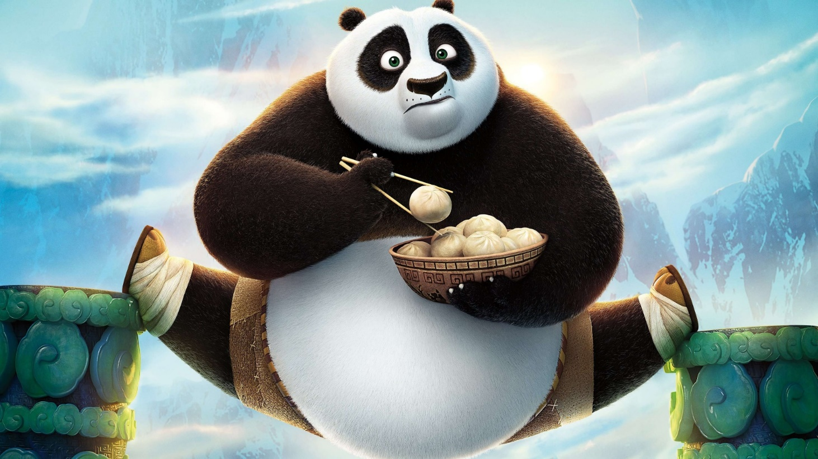
Image Showing one of the Animation Movies

Slide 4
CONT’
Children can perceive animation movies easily.
Just as the normal movies, animations uses various techniques.
This techniques involve the use of music, stop motion fade, J cuts, jump cuts, eye line match among others.
These techniques is to make the animation movies interesting.
They also draw the viewers attention.
Notes:
Animations are very important because children can perceive them easily compared to other movies. Through animation movies, people have been able to tell their stories, ideas, and communicate their emotions. Creation of animation movies shows a lot of creativity in the use of editing techniques such as stop motion , animatronics, motion capture, rotoscoping, fade, jump cuts among others.

Slide 5
Use of Stop Motion in Animation Movies
Stop motion technique is the way through which objects appear to be in motion (Shaw, 2012)
Objects in motion can also change.
Objects commonly used are Puppets or plasticine figures.
For successful stop motion, software's such as Dragonframe.
Notes:
Stop motion technique is a used while making animations by manipulating objects to appear as though they are in motion and appear to be huge. Through this technique, series of frames also (Shaw, 2012). Through stop motion, video production has become possible. The cost of using stop motion depends with how long the project takes and the quality of the animation movie required. Puppets and plasticine seem to appear as though they are in motion during the film making. Computer softwares are used to make animation movies. Commonly used softwares include dragonframe, istopmotion, stop motion pro among others.

Slide 6
Use of stop motion in Strike
Strike is an animation movie that was realised in April 2020.
The movie was released by gigglefish.
The animation movie uses stop motion.
Puppets are used in these movie.
The movie is about a mole with a goal .
The movie is a handmade stop motion.
Notes:
Strike is an example of an animation movie that uses stop motion. In these movie, puppets resembling moles have been used by the storyteller to bring the movie into life.

Slide 7
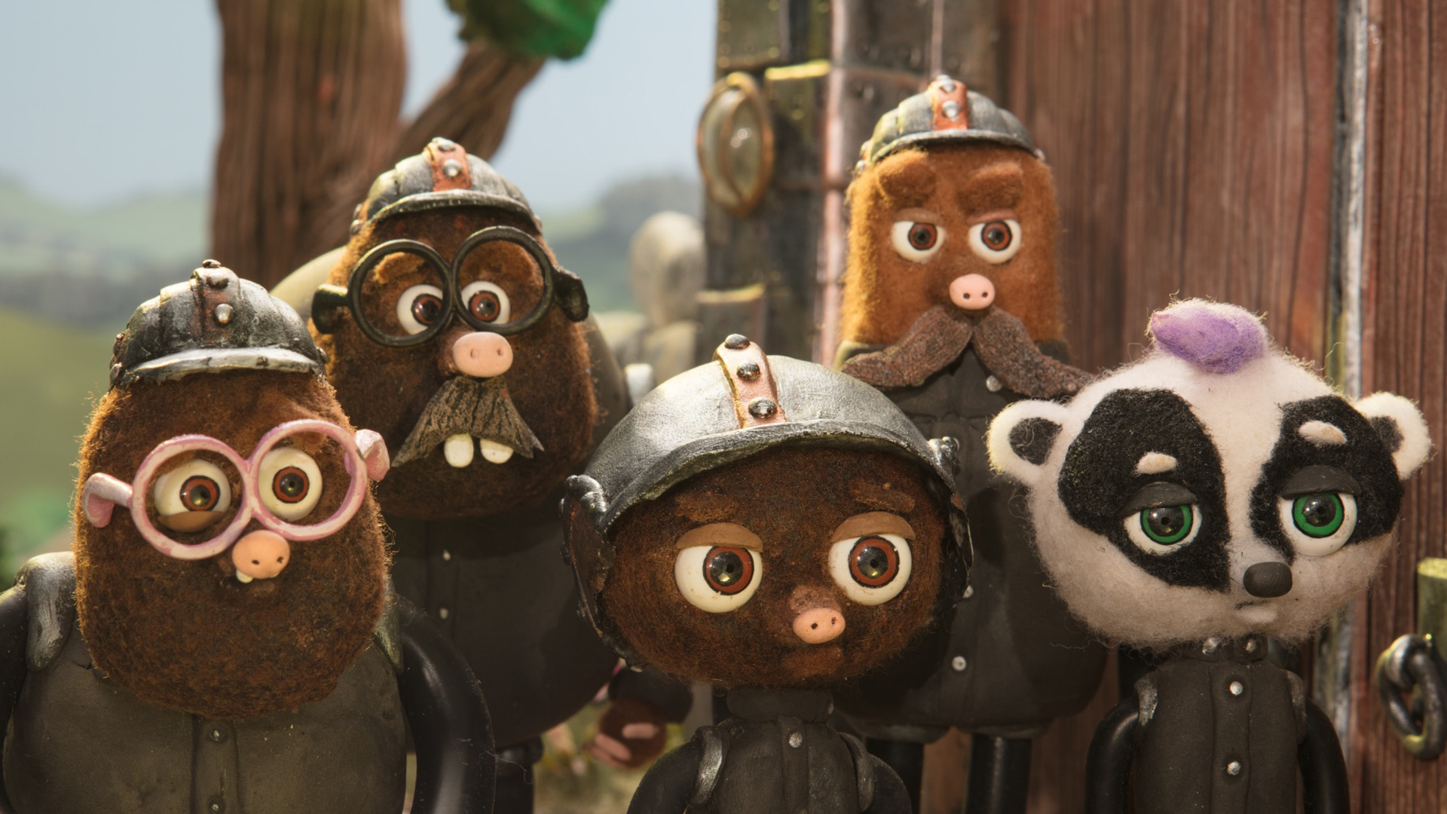
Image of the Strike Animation Movie

Slide 8
CONT’
Mole puppets photographs have been played together.
A higher speed is used to make an illusion to the viewer.
Different frames have been used in the movie.
Through the use of stop motion software helped in the success of the movie.
After completion, music and sound effects were then added up.
The movie has a good setting with good lighting.
Notes:
Frames are defined as series of different pictures taken that are used in making the animation movies so that the puppets appear to be in motion. After creation of the movements in the strike movie, music and sound effects were then added making a complete movie. This becomes possible by the use editing softwares.

Slide 9
References
Shaw, S. (2012). Stop motion: Craft skills for model animation. Taylor & Francis.
Yang, L. (2020). On the Creation of Animation Films Based on Virtual Reality Technology. 180–183.

